Slide 1
Data Clean Up
Datatypes..
tbd
TBD
tbd
TBD
TBD

Slide 2
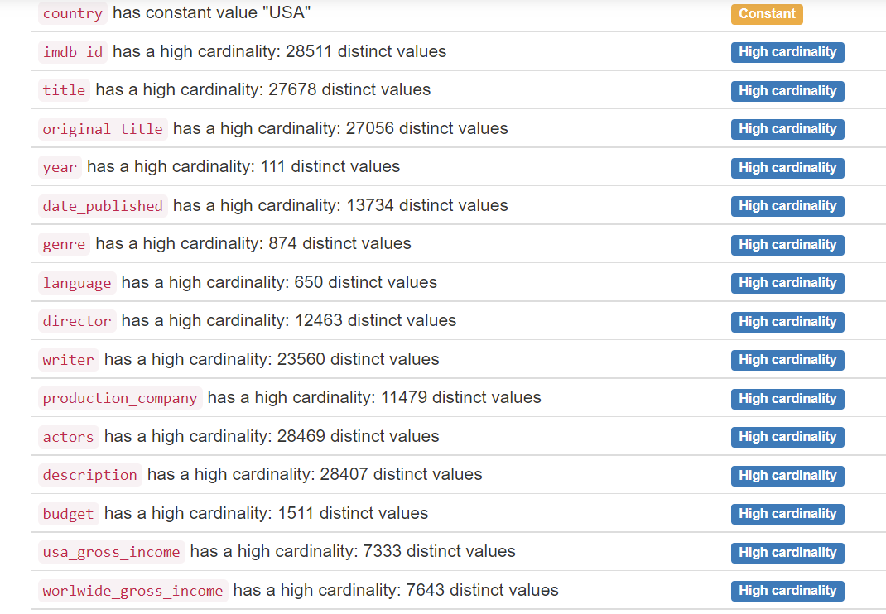
Overview of Values in Each Variable
(cardinality is a measure of set size)
Reformat into a excel table and add columns to say what we did with the data - Directors - binned, actors ignored, writers dropped, etc.

Slide 3
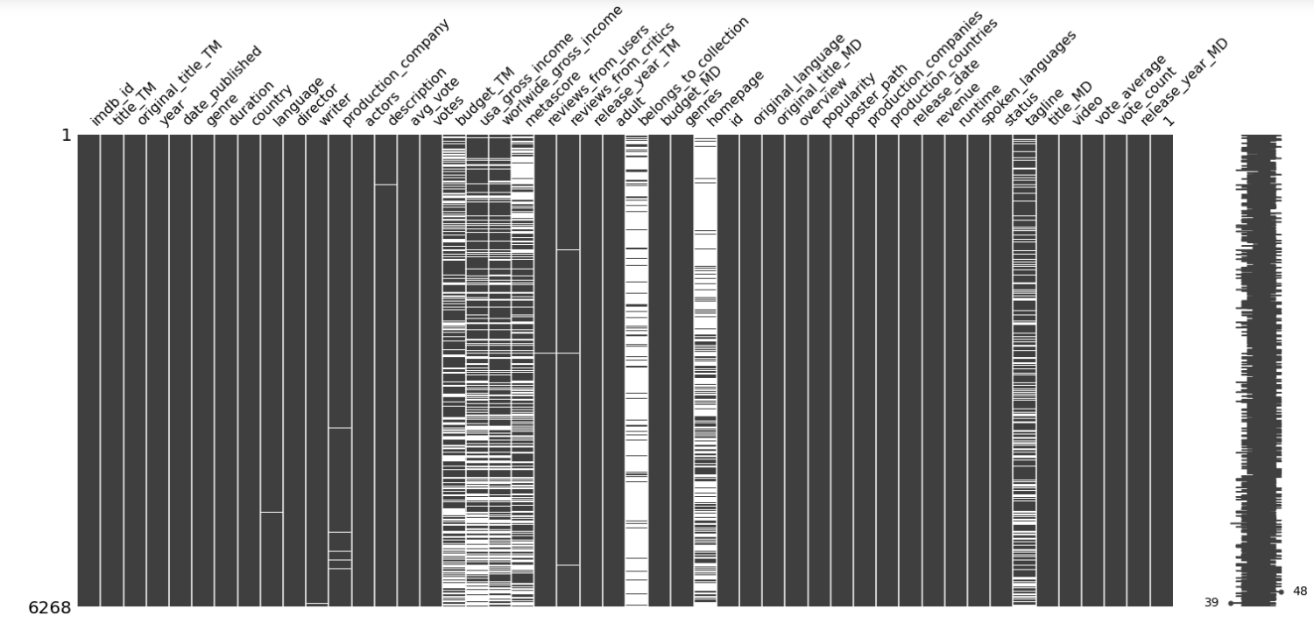
We will try to make this an interactive graph for the dashboard
Missing Data Fields by Variable (Column)

Slide 4
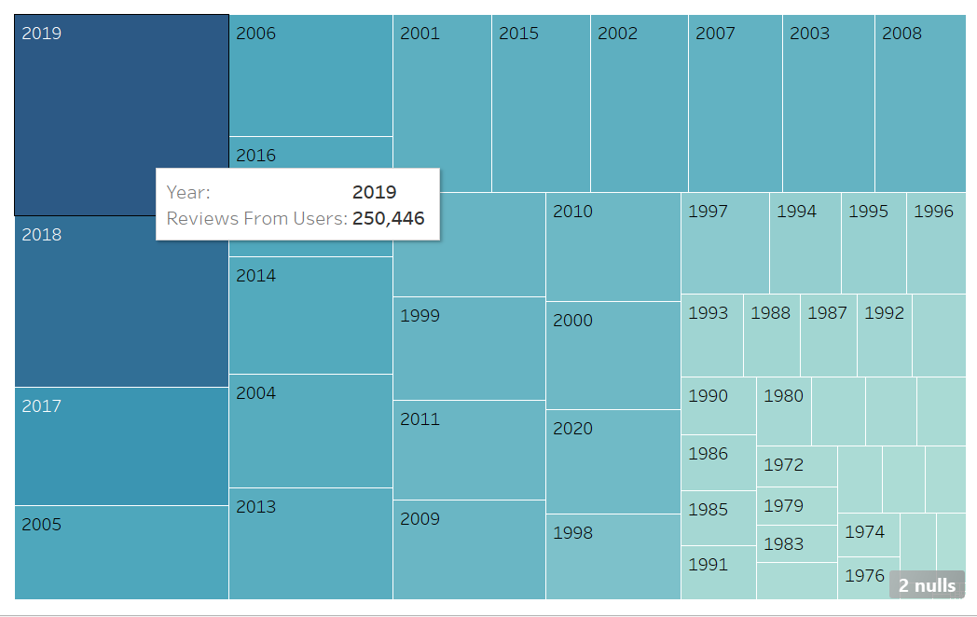

Slide 5
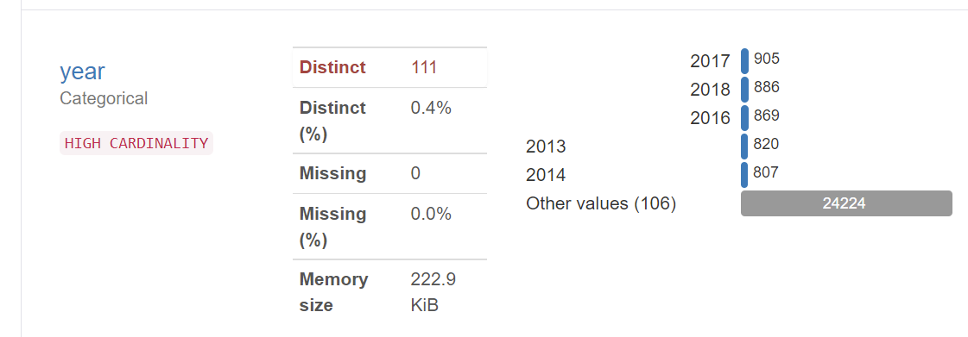
Observations in Year Variable

Slide 6
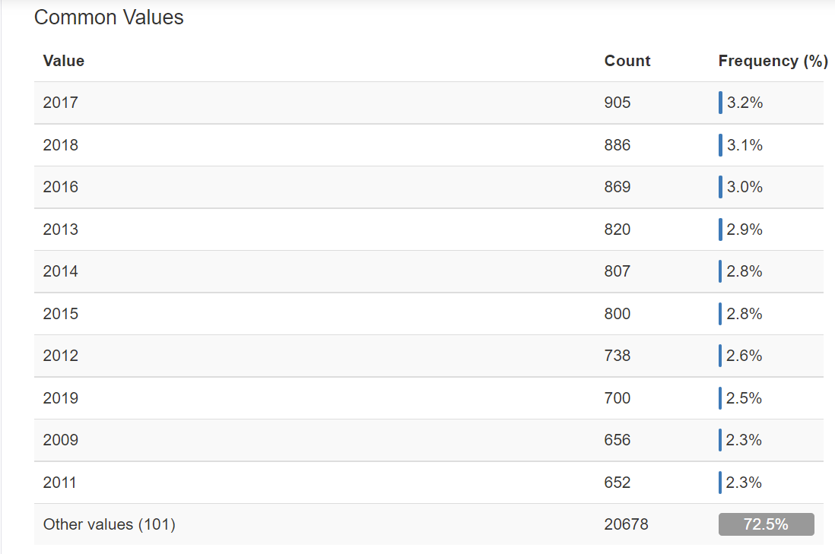
Choose which shows this better from prior slide

Slide 7
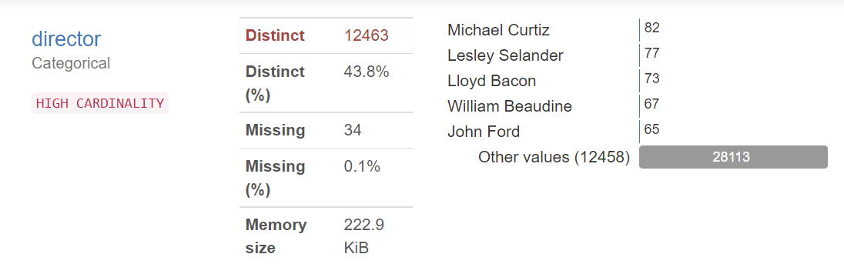
Observations in Director Variable

Slide 8
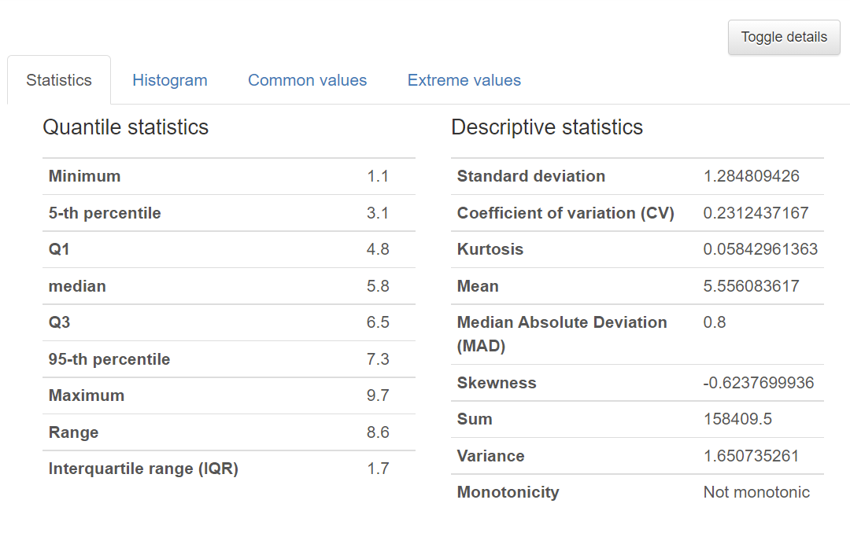
Average Vote Summary Statistics

Slide 9
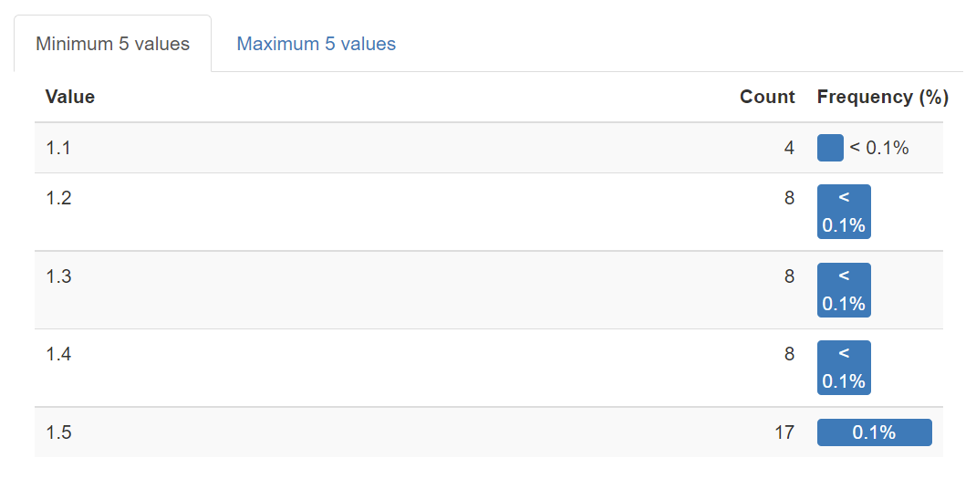
Average Vote Minimums and Maximums

Slide 10
Our Findings
Summary Statement...
tbd

Slide 11
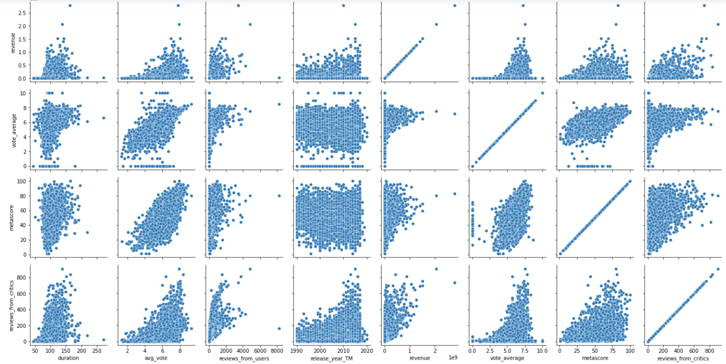
Average User Vote on IMDb vs. Average User Vote on TMDB has a Positive Correlation
Relationships of Numerical Variables in Movies Data
Notes:
Correlation coefficient between IMDb and TMDb is closely related across potentially different groups of people 0.71

Slide 12
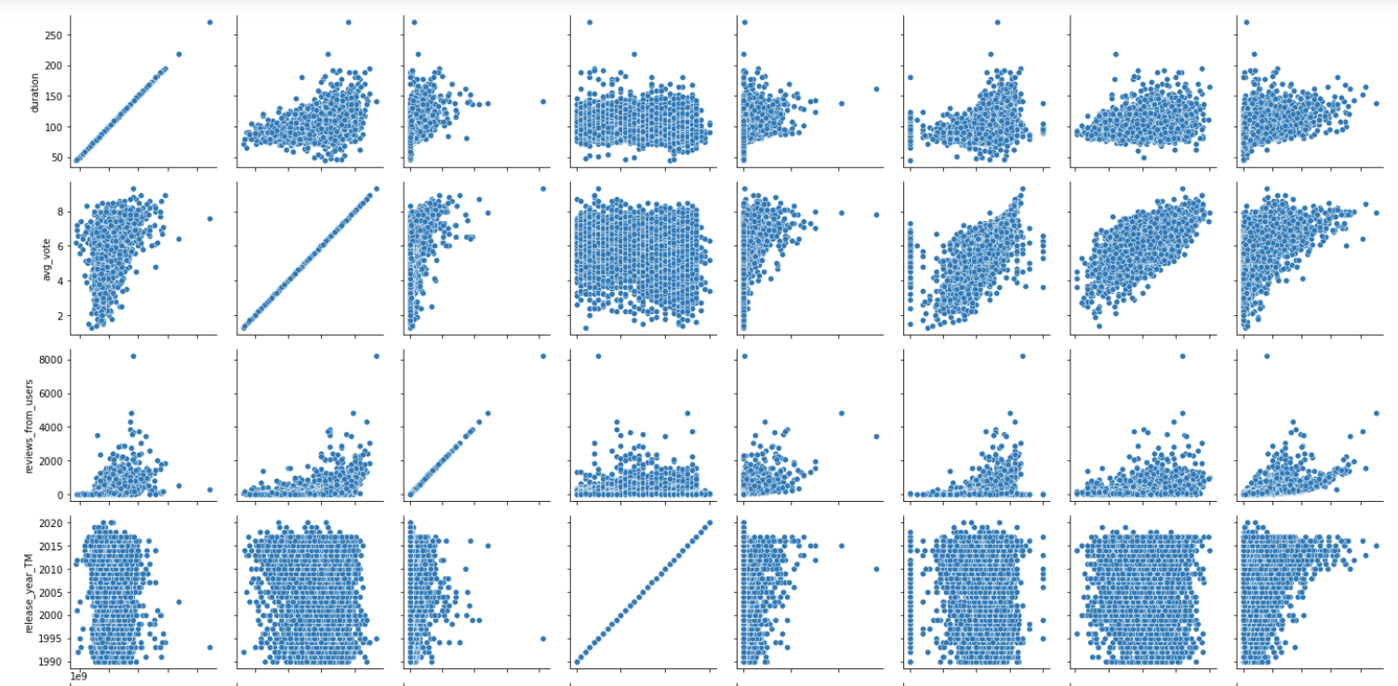
Average User Vote vs. Critic MetaScore has a Positive Correlation
Can we get a number for how correlated these are?
Relationships of Numerical Variables in Movies Data
Notes:
Correlation coefficient between average user vote and metascore is 0.67

Slide 13
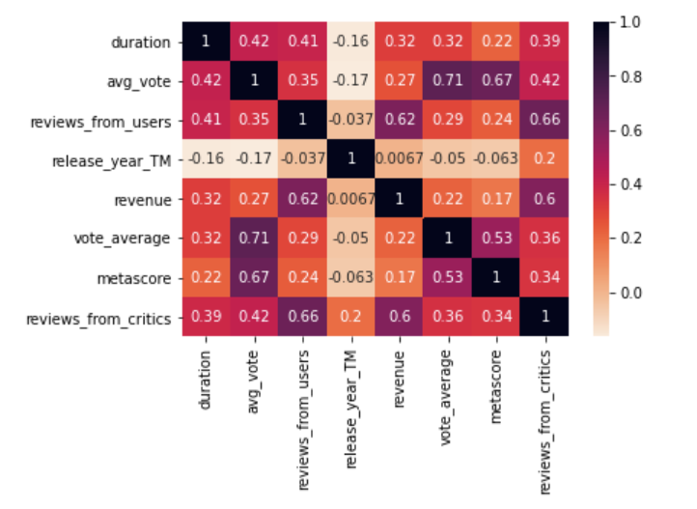
CONCLUSION:
Some positive correlation between revenue and user reviews
Duration and Release Year has minimal correlations to other variables
Note: Dropping revenue variable because data is incomplete
Correlations in Numeric Variables (Confusion Matrix)

Slide 14
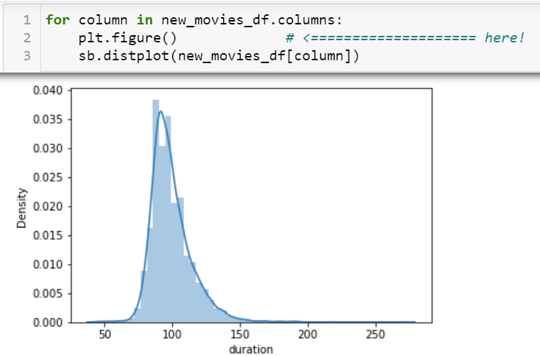
CONCLUSION:
Most movies are an average length of just over 90 minutes (mean = 93.05 minutes)
Mode is 90 minutes with a standard deviation of 18.58 minutes… (SEE SPEAKER NOTES FOR MORE MEASURES OF CENTRALITY)
This is a candidate for dashboard interactive graph when combined with other distribution data in next slides
Distribution of Movie Duration (right-skewed)
Notes:
Duration:
std. dev. = 18.58 minutes
Min = 42 minutes
Max = 398 minutes
Q1 = 84 minutes
Median = 91 minutes
Q3 = 100 minutes
IQR = 16 minutes
Mean = 93.05 minutes

Slide 15
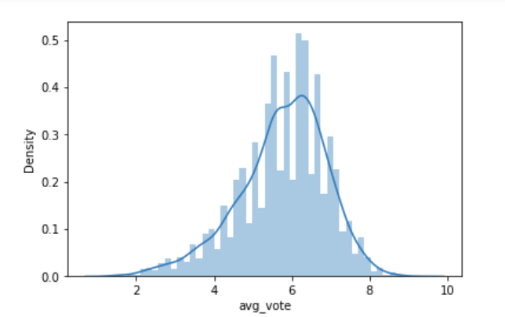
CONCLUSION:
Ellen can negotiate better deals for movies between 3-5 and can expect to pay a premium for movies above 8.
Sam may want to target ratings between 5-7 (7+ is diminishing returns).
Steel should look for movies with ratings between 7-8 to maximize time looking for his next flick.
Distribution of User Ratings on Scale 0-10 with 10 Highest
(left-skewed)
This is a candidate for dashboard interactive graph when combined with other distribution data

Slide 16
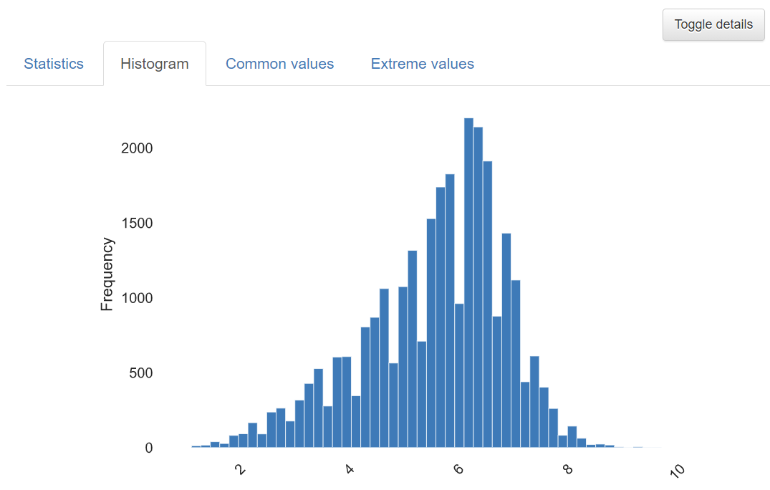
Duplicate of prior slide- Do we need this?
Distribution of Average Votes

Slide 17
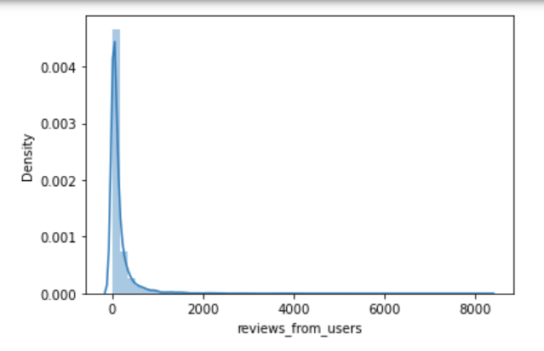
COMBINE WITH NEXT SLIDE
This is a candidate for dashboard interactive graph when combined with other distribution data
Distribution of
User Reviews Per Film
(right-skewed)

Slide 18
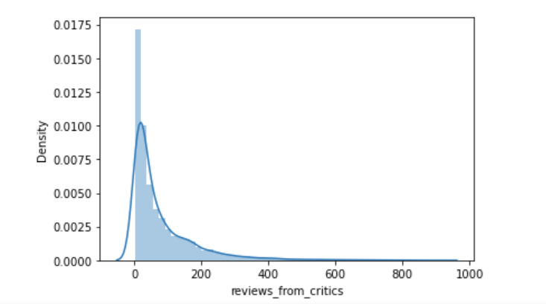
COMBINE WITH PRIOR SLIDE
This is a candidate for dashboard interactive graph when combined with other distribution data
Distribution of
Critics Reviews Per Film
(right-skewed)

Slide 19
Placeholder - How many critic reviews vs user reviews? Can we compare across datasets (IMDb v TMDB)

Slide 20
Placeholder - review counts by year
This is a candidate for dashboard interactive graph

Slide 21
Placeholder for Machine Learning Model Analysis

Slide 22
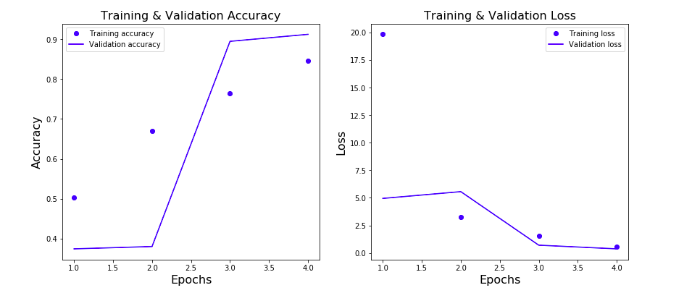
Graphs from Machine Learning
Placeholder - this is temp graphs from our machine learning model prototype

Slide 23
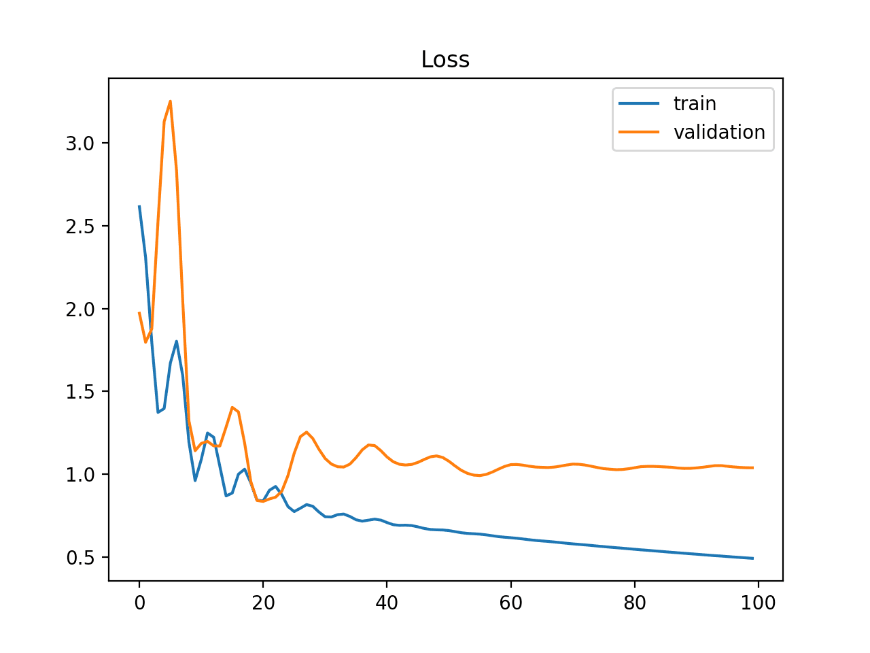
Graphs from Machine Learning
Placeholder - this is temp graphs from our machine learning model prototype

